Slide 1
APEX COLOR RUN
PROCEDURES AND EXPECTATIONS

Slide 2
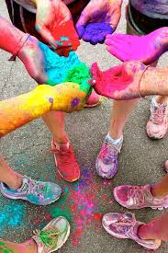
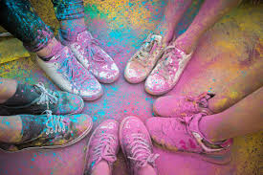
APEX COLOR RUN
Today we will be discussing the expectations for our school- wide COLOR RUN
Taking place THIS Friday!!
You will need your Advisory notebook and a pencil/pen

Slide 3
APEX COLOR RUN PROCEDURES
Friday during Advisory you will receive your Event T-shirt, Sunglasses, and a colored wristband (the wristband is for those who will be taking part in the VIP Color Battle the last 30 minutes of the Run!!
Please put your shirt over the shirt you are already wearing for the day
You will also receive a plastic bag that you will be putting your binders, and backpacks into. EVERYTHING GOING HOME NEEDS TO GO IN THIS BAG!! This bag will go outside with you as you will NOT be allowed to re-enter the building after going outside.
Advisory classes will be called to the field according to the most money raised to the least.
In your Advisory notebook summarize the Apex Color Run Procedures in your own words.

Slide 4
APEX COLOR RUN EXPECTATIONS
To participate in the school- wide APEX Color Run you MUST have your waiver turned into your Advisory Teacher!!
Students not participation (NO waiver form) will go to an alternative setting
You will stay outside with your Advisory, in your assigned area until your Advisory has been called to join the course
You may walk OR run the course
Help clean up trash at the end of the day
Follow the S.T.R.I.K.E Matrix
In your Advisory notebook, using S.T.R.I.K.E write one expectation for each letter for the APEX Color Run

